Slide 1
The Terminator to Android Hardening Services
1

Slide 2







Slide 3
Outline
Background
DexHunter
Analysis of major products
Related resources
3

Slide 4
Outline
Background
DexHunter
Analysis of major products
Related resources
4

Slide 5
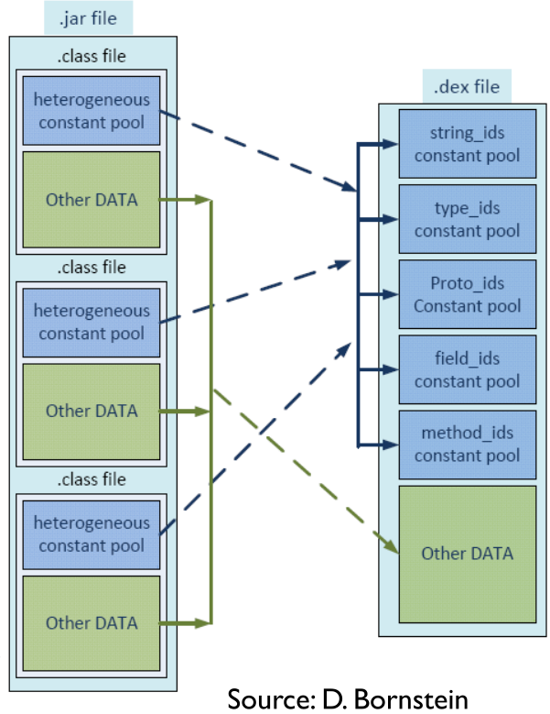
Dex File
Java source code -> Java class -> dex
Java class: each file contains one class
dex: one file contains all classes
Reorganize constant pools in each class file into shared and type-specific constant pools
5

Slide 6
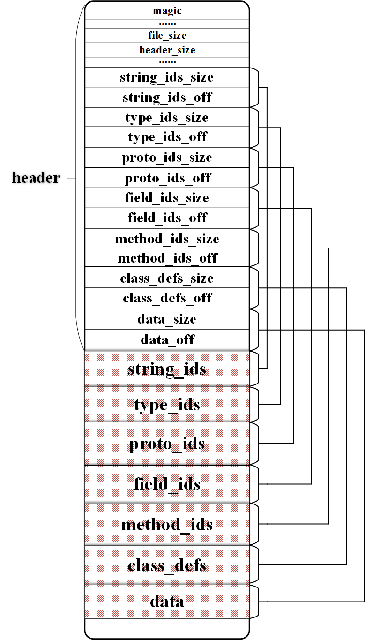
Dex File
The executable of an App.
The header contains the length
and the offset for each section.
class_defs section contains
class_def_items, each of which describes a class.
6

Slide 7
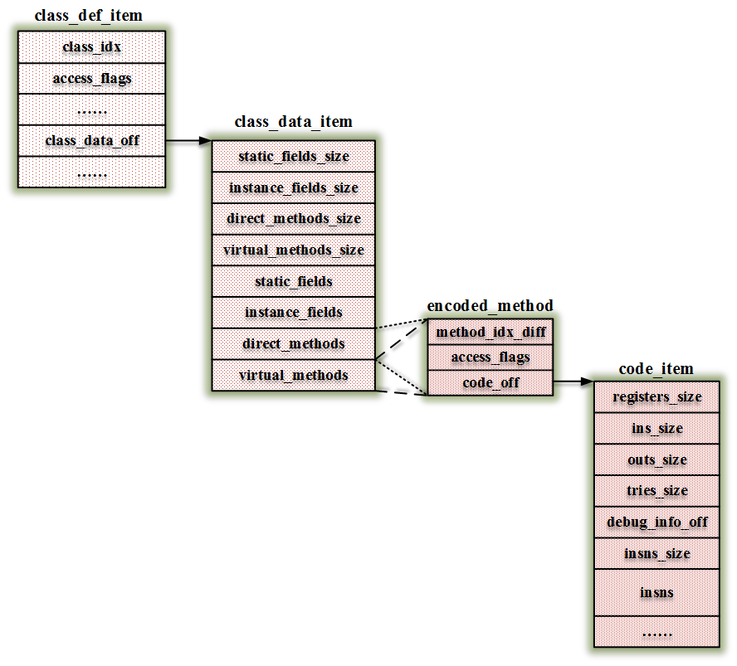
class_def_item
A class_def_item points to a class_data_item.
A class_data_item contains the data of a class.
Each method is described by an encoded_method.
An encoded_method points to a code_item.
A code_item contains the
instructions of a method.
7

Slide 8
OAT File
It is generated while an app is installed or a jar file is loaded.
/frameworks/base/services/java/com/android/server/pm/PackageManagerService.java
Constructor method → scanDirLI ()→
scanPackageLI()→performDexOptLI()→mInstaller.dexopt()
It is an ELF file.
8

Slide 9
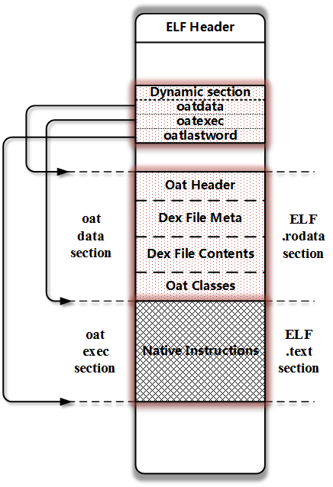
OAT File
Three symbols in dynamic section.
oatdata
oatexec
oatlastword
The original dex file is contained in the oatdata section.
The compiled native instructions are contained the oatexec section.
9

Slide 10
Outline
Background
DexHunter
Where to unpack the app?
When to unpack the app?
How to unpack the app?
Analysis of major products
Related resources
10

Slide 11

Where to dump dex file?
Four occasions
Opening a Dex file;
Loading a class;
Initializing a class;
Invoking a method;
11

Slide 12

Opening a Dex File
Operations
Open an APK file;
Check whether it has been cached;
If not, extract the dex file from the APK and generate the cached
dex file;
Open the cached dex file.
12

Slide 13
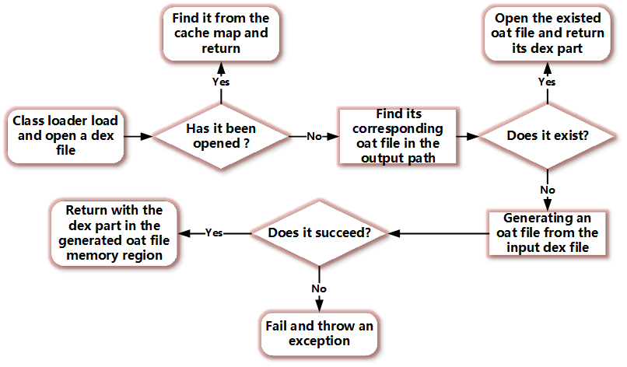
Procedure of Opening a Dex File in ART
13

Slide 14

Loading a Class
Operations
Form a class object from the data;
Verify the legitimacy of access flags and the data;
Populate all fields in the class object;
Deal with its super classes and/or interfaces;
Conduct some other checking.
14

Slide 15
Two Ways of Loading a Classes
Explicit approach
Class.forName(), ClassLoader.loadClass().
Implicit approach
E.g., new operation, accessing static members, etc.
15

Slide 16
Implementation in ART
Explicit
ClassLoader.loadClass →DexFile_defineClassNative
Class.forName →Class_classForName
Implicit
new operations and so on→ artAllocObjectFromCode
16

Slide 17
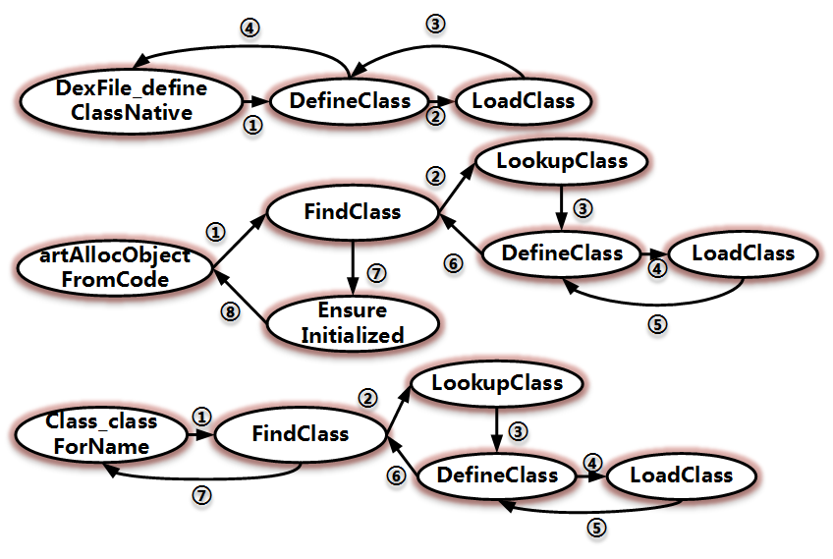
Implementation in ART
17

Slide 18
Implementation in DVM
Explicit
ClassLoader.loadClass→Dalvik_dalvik_system_DexFile defineClassNative
Class.forName →Dalvik_java_lang_Class_classForName
Implicit
new operations and so on→ dvmResolveClass
18

Slide 19
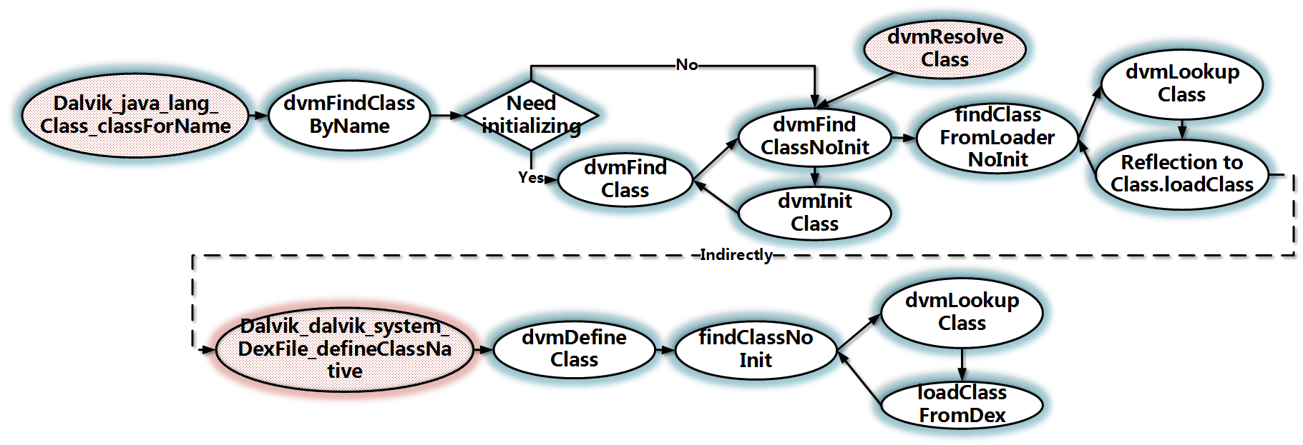
Implementation in DVM
19

Slide 20
Class Loaders at Java Level
Three class loaders
BootClassLoader
It is used for loading system classes.
DexClassLoader
It is used for loading external files.
PathClassLoader
It is used by the framework.
20

Slide 21
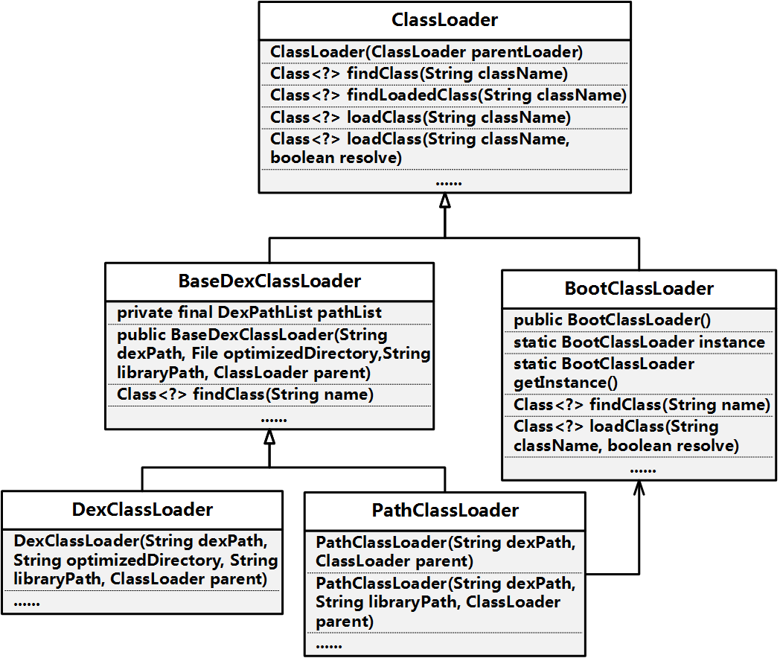
Inheritance Relationship
21

Slide 22
Parent Delegation Model
Class<?> loadClass(String className, boolean resolve {
Class<?> clazz = findLoadedClass(className);
if (clazz == null) {
clazz = parent.loadClass(className, false);
}
if (clazz == null) {
clazz = findClass(className);
}
}
return clazz;
}
22

Slide 23
Parent Delegation Model
Each subclass of ClassLoader implements its own findClass().
Each subclass of ClassLoader inherits loadClass() except BootClassLoader.
23

Slide 24
Differences between Java and Android
defineClass() in ClassLoader (Android) is not implemented.
Throw UnsupportedOperationException
URLClassLoader in Android also cannot load a class, because
URLClassLoader.findClass() → URLHandler/URLJarHandler.findClass()→
createClass ()→
ClassLoader.defineclass()
24

Slide 25
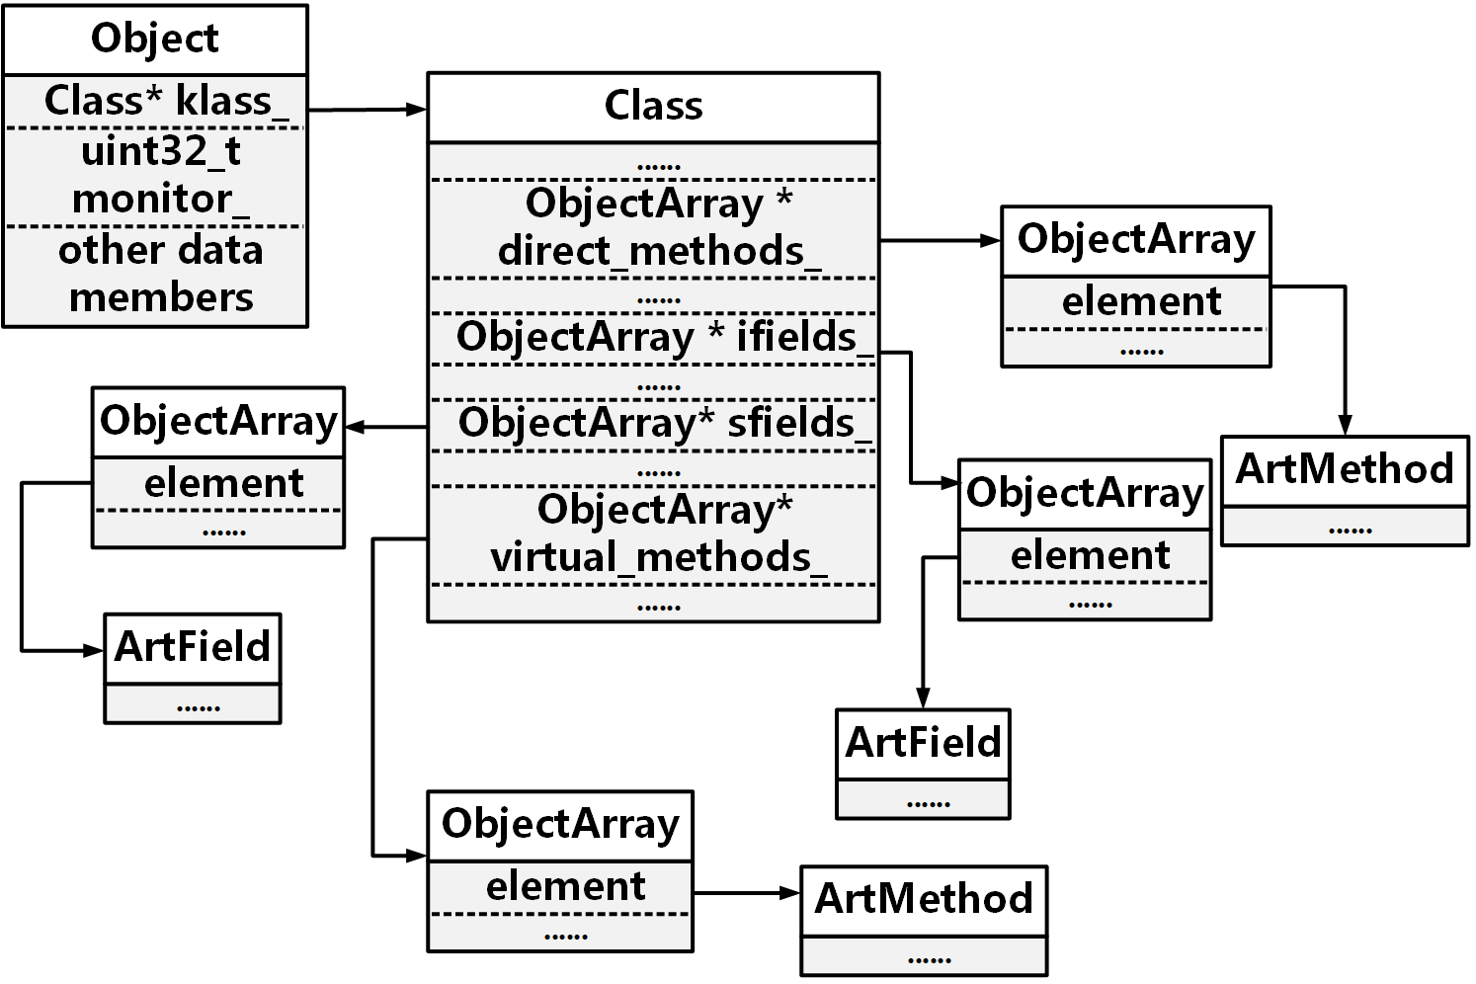
A Loaded Class Object in ART
25

Slide 26
A Loaded Class Object in DVM
26

Slide 27
When does Initializing Classes happen?
Before the class object is used;
Before the first static data member is accessed;
Before the first static method is invoked;
Before the first instance is generated;
…
27
Notes:
In compiled dex files, the static blocks in a Java class are transformed into <clinit> method;
Invoking <clinit> methods to manipulate class objects;

Slide 28
Invoking a Method
DVM or ART interpreting mode
Execute the instructions in the code_item.
ART native mode
Execute the native instructions in oatexec section.
28
Notes:
Tips:
The framework is compiled as an oat file, relying on target devices;
Compiled apps depend on the compiled framework;
Compiled oat files are useless on other devices;
For compatibility, hardening products forces apps running in interpreting mode in ART
28

Slide 29

When to unpack the app?
When the first class of the app is being loaded.
Why?
Before a class is loaded, the content of the class should be available in the memory;
When the class is initialized, some content in memory may be modified dynamically;
Just before a method is invoked, its code_item or instructions should be available.
How?
Load and initialize all classes proactively.
29

Slide 30

How to unpack the apk?
Integrate our tool into Android runtime including DVM and ART.
Wait for the proper occasion.
Locate the target memory region.
Dump the selected memory.
Correct and reconstruct the dex file.
30

Slide 31
DexHunter
Collected code_item
Memory
Space
part1
split
collect
write
Locate
Target Region
Parsing each class
DexClassData
extra
correct
write
split
Collected DexClassData
Copy each clas_def_item and correct if needed
data
class_def_item
write
classdef
31

Slide 32
Loading & Initializing Classes
Traverse all class_def_items in the dex file.
For each one, we load it with FindClass function (ART) or dvmDefineClass function (DVM).
Then we initialize it with EnsureInitialized function (ART) or dvmIsClassInitialized & dvmInitClass functions (DVM).
32

Slide 33

Locating the Target Memory Region
The target memory region contains the dex file.
We use a special string to determine whether the current dex file is what we want.
33
Notes:
33

Slide 34
The Special String in ART
ART: the string “location_” in DexFile objects.
The opened apk file’s path →
dex_file_location in generated oat file’s header
→ dex_file_location_ in OatDexFile objects
→ location_ in DexFile objects by function DexFile::Open
34

Slide 35
The Special String in DVM
DVM: the string “fileName” in DexOrJar objects.
The opened apk file path→
fileName in DexOrJar objects by function
Dalvik_dalvik_system_DexFile_openDexFileNative.
For Dalvik_dalvik_system_DexFile_openDexFile_bytearray, fileName is always equal to “<memory>”.
35

Slide 36
Extracting the Dex File in Memory
Divide the target memory region
Part 1: the content before the class_defs section
Part 2: the class_defs section
Part 3: the content after the class_defs section
Dump part 1 into a file named part1 and part 3 into a file named data.
36

Slide 37
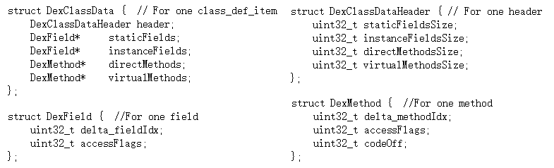
Parsing the Content
Parse class_defs section.
Getting each class_data_item from class_def_item.
Read the corresponding content into a DexClassData object.
Notice: some fields in a class_data_item are encoded by LEB128 algorithm.
37

Slide 38
Correcting and Collecting
Why?
Packing services may modify the memory dynamically.
The memory consists of the region containing the dex file and the
method objects (i.e., ArtMethod in ART, Method in DVM) managed by runtime.
The runtime executes instructions according to the managed method objects.
38

Slide 39
Correcting and Collecting
We check each:
class_data_off in class_def_item.
accessflag and codeoff in DexMethod of parsed class_data_item (i.e., DexClassData object).
39

Slide 40

How?
Determine whether the class_data_off in class_def_item exists in the scope of the dex file.
Copy all class_def_items and write them into a file named classdef.
Collect the outside class_data_items into a file named extra.
Correct the fields in selected DexClassData object according to the managed method object.
40
Notes:
Some content in the original dex file is relocated to other places out of the file.

Slide 41
Scenario I
Compare the accessFlags in DexMethod with the access flag in the managed method object.
Compare the codeoff in DexMethod with the code_item_off in the managed method object.
If at least one is not equal, we modify the value in the DexMethod object according to the managed method object and write the relevant DexClassData into extra file.
41
Notes:
Some DexMethods may be native method while the managed method objects are changed to effective Java methods to hide codes

Slide 42
Scenario II
Check whether code_item_off exists in the scope of the dex file.
If not, we collect the correct code_item and write it into extra file.
42

Slide 43
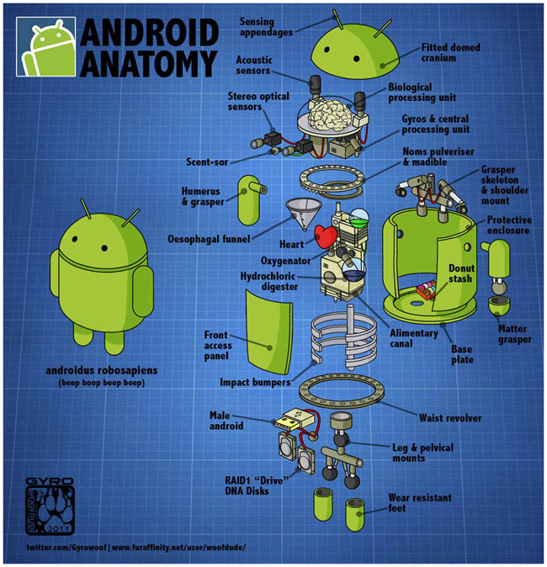
Reconstructing the Dex File
We now have four files: part1, classdef, data, extra.
We combine them as the sequence
(1) part1
(2) classdef
(3) data
(4) extra
Finally, we obtain a complete dex file.
43

Slide 44
Outline
Background
DexHunter
Analysis of major products
Related resources
44

Slide 45





Products under Investigation
360 http://jiagu.360.cn/
Ali http://jaq.alibaba.com/
Baidu http://apkprotect.baidu.com/
Bangcle http://www.bangcle.com/
Tencent http://jiagu.qcloud.com/
ijiami http://www.ijiami.cn/
45

Slide 46


Experiment Setup
46

Slide 47
String List
360 | /data/data/XXX/.jiagu/classes.dex
Ali | /data/data/XXX/files/libmobisecy1.zip
Baidu | /data/data/XXX/.1/classes.jar
Bangcle | /data/data/XXX/.cache/classes.jar
Tencent | /data/app/XXX-1.apk (/data/app/XXX-2.apk)
ijiami | /data/data/XXX/cache/.
XXX stands for its package name.
47

Slide 48

Anti-debugging
All products detect debugger
Anti-ptrace
Anti-JWDP
….
They cannot detect DexHunter.
48

Slide 49
360
Version: 06-21-2015
It encrypts the dex file and saves it in libjiagu.so/libjiagu_art.so.
It releases the data into memory and decrypts it while running.
49

Slide 50
Ali
Version: 21-06-2015
It splits the original dex file into two parts
One is the main body saved in libmobisecy.so
The other one contains the class_data_items and the code_items of some class_def_items.
It releases both two parts into memory as plain text and corrects some offset values in the main body while running.
Some annotation_offs are set to incorrect values.
50

Slide 51

Baidu
Version: 21-06-2015
It moves some class_data_items to other places outside the dex file.
It wipes the magic numbers, checksum and signature in the header after the dex file has been opened.
51

Slide 52
Baidu
It fills in an empty method just before it is invoked and erases the content after the method is finished.
We instrument method invocation to dump these methods which is available only just before invoking.
DoInvoke (ART)
dvmMterp_invokeMethod (DVM)
52

Slide 53
Bangcle
Version: 21-06-2015
It prepares the odex file or oat file in advance.
It encrypts the file and stores it in an external jar file.
It decrypts the data while running
It hooks several functions in libc.so, such as
read,write, mmap, …
53
Notes:
Hook：
judging whether the first eight bytes of the buffer being written out are equal to the magic numbers of a dex file or not
checking the first eight bytes of the file being mapped
If hit, the function will fail.

Slide 54
ijiami
Version: 21-06-2015
Similar to Bangcle
The string changes every time the app runs.
It releases the decrypted file, which is also encrypted as a jar file, with different file names each time while they are in the same directory.
54

Slide 55
Tencent
Version: 25-05-2015
It can protect the methods selected by users.
If a method is selected, it cannot be found in the relevant class_data_item.
It releases the real class_data_item and adjusts the offset.
The code_item of the selected method is still in the data section.
Some annotation_offs and debug_info_offs are set to 0xFFFFFFFF.
It can only runs in DVM.
55

Slide 56
Outline
Background
DexHunter
Analysis of Major Products
Related resources
56

Slide 57
Related resources
https://source.android.com/devices/tech/dalvik/dex-format.html
/libcore/libart/src/main/java/java/lang/ClassLoader.java
/libcore/libdvm/src/main/java/java/lang/ClassLoader.java
/libcore/dalvik/src/main/java/dalvik/system/DexClassLoader.java
/libcore/dalvik/src/main/java/dalvik/system/PathClassLoader.java
https://github.com/anestisb/oatdump_plus#dalvik-opcode-changes-in-art
57

Slide 58
DEMO

Slide 59

59

